Slide 1
Subject-Web Application Development
Class-2 B
[Components in React]
Notes:
1

Slide 2
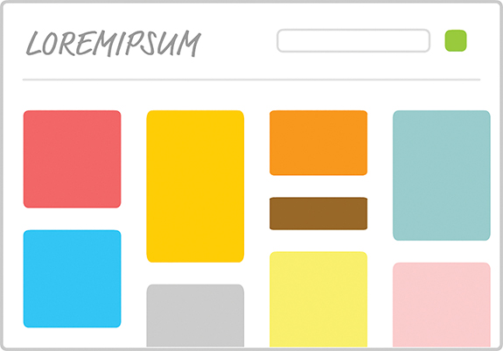
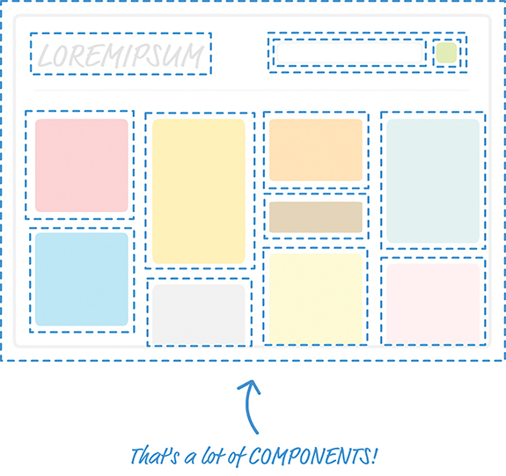
Components in React
Components define visuals & interactions that make up what people see in your app.
Consider smaller parts of the greater visuals here.
Components in react is a small piece of representation for the visuals.
Think of Components as being very similar to functions.
Your hypothetical finished app.
4/17/2023
Web Application Development-Class2
2

Slide 3
Components in React
Quick Review of Functions
In JavaScript, you have functions that enable you to make your code a bit cleaner and more reusable.
Conceptually, functions share a lot of surface area with React components, and the easiest way to understand what components do is to take a quick look at functions first.
In a terrible world where functions don’t exist, you might have some code that looks as follows:
4/17/2023
Web Application Development-Class2
3

Slide 4
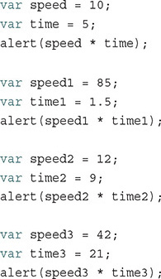

Components in React
Quick Review of Functions
function getDistance(speed, time) {
var result = speed * time;
alert(result);
}
4/17/2023
Web Application Development-Class2
4

Slide 5
<!DOCTYPE html>
<htm>
<head>
<meta charset="utf-8">
<title>React Components</title>
<script src="https://unpkg.com/react@16/umd/react.development.js"
></script>
<script src="https://unpkg.com/react-dom@16/umd/react-
dom.development.js"></script>
<script src="https://unpkg.com/babel-
standalone@6.15.0/babel.min.js"></script>
<style>#container {
padding: 50px;
background-color: #EEE;
}
#container h1 {
font-size: 144px;
font-family: sans-serif;
color: #0080A8;
}
</style>
</head>
<body>
<div id="container"></div>
var destination = document.querySelector(“#container”);
<script type="text/babel">
</script>
</body>
l</html>
ReactDOM.render(
<div>
<p>Hello, world!</p>
</div>,
document.querySelector("#container")
);
class HelloWorld extends React.Component {
render() {
return <h1>Hello, world!</h1>
}
}
ReactDOM.render(
<HelloWorld/>,
document.querySelector("#container")
);
4/17/2023
Web Application Development-Class2
5

Slide 6
Meet the React Component
Specifying Properties
Part 1: Updating the Component Definition
class HelloWorld extends React.Component {
render() {
return <p>Hello, {this.props.greetTarget}!</p>
}
}
You access a property by referencing it via this.props property that every component has access to.
In JSX, if you want something to get evaluated as an expression, you need to wrap that something inside curly brackets. If you don’t do that, you’ll see the raw text this.props.greetTarget printed out.
4/17/2023
Web Application Development-Class2
6

Slide 7
Meet the React Component
Modifying the Component Call
Part 2: Modifying the Component Call
ReactDOM.render(
<div>
<HelloWorld greetTarget="Batman"/>
<HelloWorld greetTarget="Iron Man"/>
<HelloWorld greetTarget="Nicolas Cage"/>
<HelloWorld greetTarget="Mega Man"/>
<HelloWorld greetTarget="Bono"/>
<HelloWorld greetTarget="Catwoman"/>
</div>,
document.querySelector("#container")
);
Each HelloWorld call now has the greetTarget attribute, along with the name of a superhero that we want to greet.
You are not limited to having just a single property on a
component. You can have as many properties as you want,
and your props property will easily accommodate any
property requests you have without making any fuss.
4/17/2023
Web Application Development-Class2
7

Slide 8
Meet the React Component
Dealing with Children
Use this component by calling it via the ReactDOM.render below method,
Just as you can have many HTML elements, your
components can have children. This means you can do something like this:
ReactDOM.render(
<div>
<Buttonify behavior="submit">SEND DATA</Buttonify>
</div>,
document.querySelector("#container")
);
class Buttonify extends React.Component {
render() {
return(
<div>
<button type={this.props.behavior}>{this.props.children}
</button>
</div>
);
}
}
For styling
Inside <style> tag,
Button {
font-size: 64px;
}
4/17/2023
Web Application Development-Class2
8

Slide 9
Thing to Remember!
Matter of Fact
if your child element is just some text, the this.props.children property returns a string.
If your child element is just a single element (as in example), the this.props.children
property returns a single component that is not wrapped inside an array.
Keep in Mind
Your Components must always be capitalized.
Inside render, you output the JSX you want to return
To evaluate an expression, wrap it inside { and } characters.
You can call a component directly by wrapping its name in < and > characters.
4/17/2023
Web Application Development-Class2
9

